Slide 1

Welcome back!
Studio S11
Ma Chi Kin Brian
e1121386@u.nus.edu
Tele: @bmanara

Slide 2
Final Stretch!

Slide 3
Agenda for Today
Admin Matters
Recap
S11 Studio Worksheet
S11 In-class Studio Worksheet

Slide 4
Admin Matters
Mastery Check 2
Topics covered:
Environments of Programs (Env Model)
Memoization
Streams
Either F2F or Zoom Online Meeting
My free Time Slots
Monday: 1400hrs - 1630hrs (F2F/Online)
Wednesday: Whole Day (F2F/Online)
Thursday: 1000hrs onwards (F2F/Online) Public Holiday
Friday: 1200hrs onwards (F2F/Online) NUS Wellness Day
Or lmk what other timeslots you intend to meet up (I’ll see what I can do)
*Next Monday (Week 12) 1420hrs - 1500hrs, I’m not free.
Notes:
Prepare a “presentation” on the topics covered
Will have to show that you have “mastered” the topic
Pass/Fail Grading
Ensure that your pair understands and can explain too!
Pass/fail is given together as a pair…
Can either use presentation slides, drawings, Source Academy examples etc.
After your presentation, I’ll present some questions about the 3 topics.

Slide 5
Admin Matters
If possible, try to clear by this week. Practical Assessment is coming soon (Week 12)!
Else, after the Practical Assessment is fine as well though so no pressure…
Stick with the same pairs as MC1? Or do you want to shuffle around…?

Slide 6
Admin Matters
CP3108A/B (2/4 MCs)
Project module on Source Academy
Application starts on Week 12 (Friday) to Week 13 (Friday)
Apply if interested! Look out for announcements
Avenger Recruitment
Application starts on 15/11/2024 (Friday, Week 13) to 13/01/2025 (Monday, Week 1)
Interviews will be done during Semester 2
Do let me know if you are applying! (I can recommend yalls to the teaching staff)
Highly recommend to try for both, cause why not?

Slide 7
RECAP
Streams I & II
Memoized Streams
Metalinguistic Abstraction I*
Notes:
*Quick runthrough, main focus for this studio is Streams…

Slide 8
Streams I (Revisit)
Main Idea:
Delayed Evaluation!
Functions allow us to describe an activity without actually doing it.
Delayed Lists
Our pairs contain a data item as head, but a function as tail. This function can be activated whenever needed
Streams are “Lazy” Lists!
Stream Discipline
A stream is either the empty list, or a pair whose tail is a nullary function that returns a stream.

Slide 9
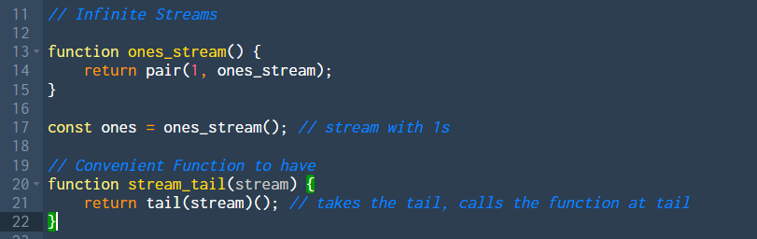
Streams I (Revisit)
Infinite Streams

Slide 10
Streams I (Revisit)
Stream Processing
stream_tail(stream)
stream_map(stream)
stream_filter(stream)
https://docs.sourceacademy.org/STREAMS/index.html

Slide 11
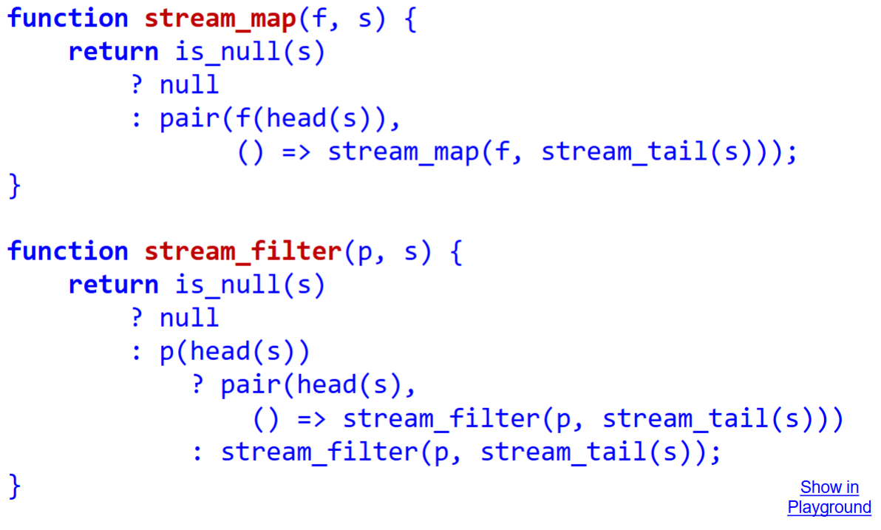
Streams I (Revisit)

Slide 12
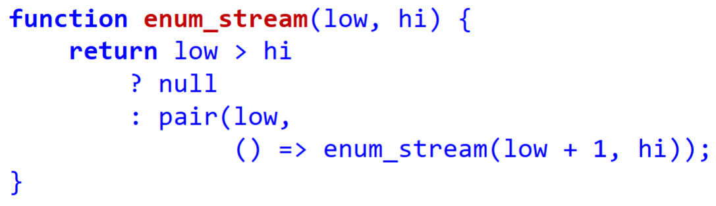
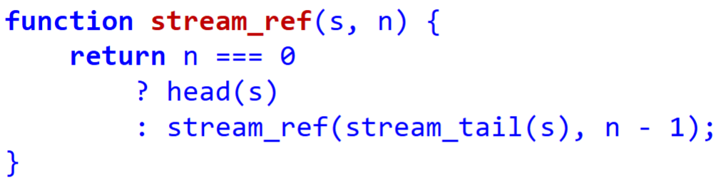
Streams I (Revisit)
Notes:
enum_stream essentially creates a stream with the numbers low to hi
stream_ref gets the element at the n position/index.

Slide 13
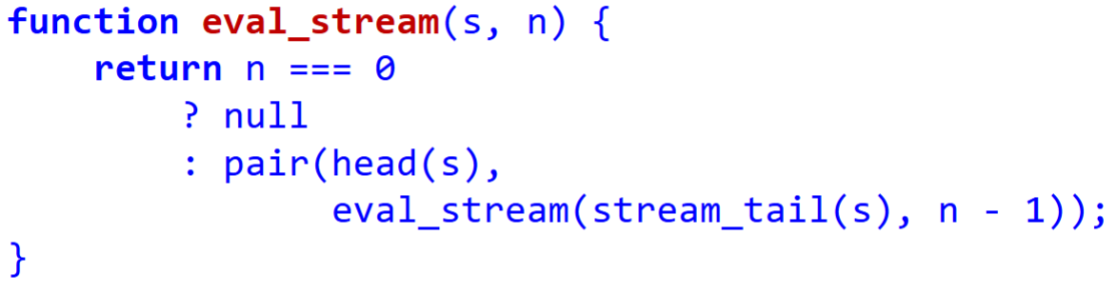
Streams I (Revisit)
Notes:
eval_stream Creates a list of the first n elements in the stream

Slide 14
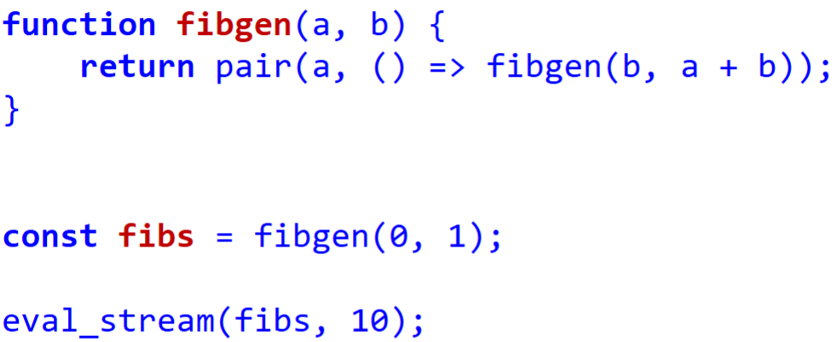
Streams I (Revisit)
Notes:
fibgen(a, b) produces a fibonacci sequence (infinite stream).

Slide 15
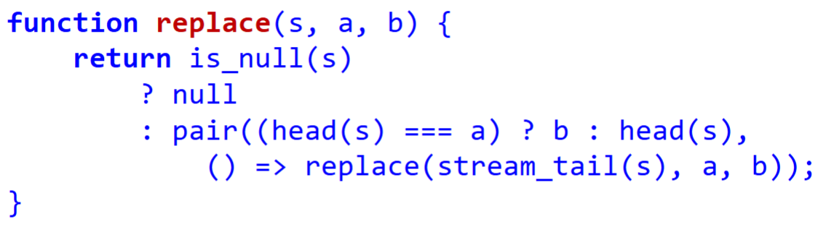
Streams II
replace function
Creates a new stream by replacing in a given stream a particular value with a new given value
Notes:
Explain how replace works. (If possible, get students to explain to us instead)

Slide 16
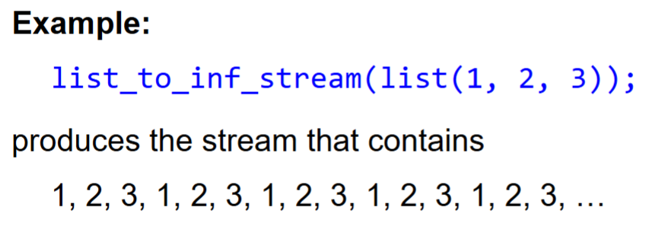
Streams II
list_to_inf_stream function
Takes in a list and returns a stream that repeats the list infinitely
Overall strategy?
Notes:
Anyone knows the overall strategy on implementing this?
Traverse the list as per usual while building stream. If i hit the end of the list, go back to the start of the list.
Issue is, storing out “start of the list” so that we can keep going back.
Also have to deal with the case that given list is an empty list to begin with.

Slide 17
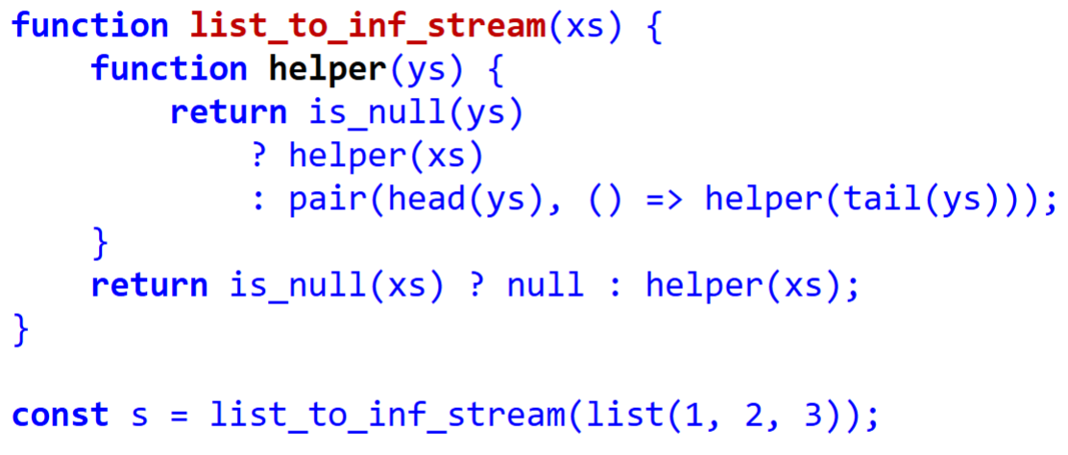
Streams II
Notes:
Anyone knows the overall strategy on implementing this?
Traverse the list as per usual while building stream. If i hit the end of the list, go back to the start of the list.
Issue is, storing out “start of the list” so that we can keep going back.
Also have to deal with the case that given list is an empty list to begin with.

Slide 18
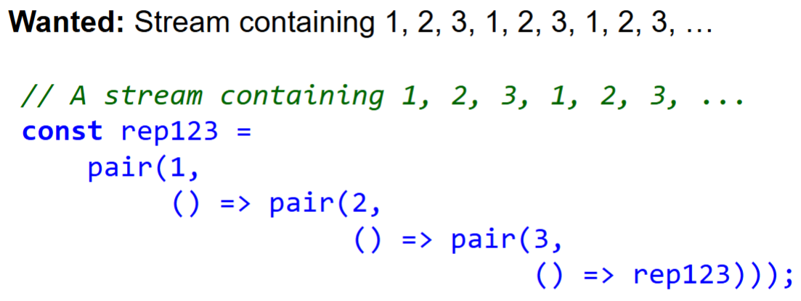
Streams II
Defining a Repeating Stream

Slide 19
Streams II
Adding two streams
Take in two streams, return a stream the contains the element-wise sums
Overall Strategy?
Notes:
When making new stream, just add both elements at the head of both.

Slide 20
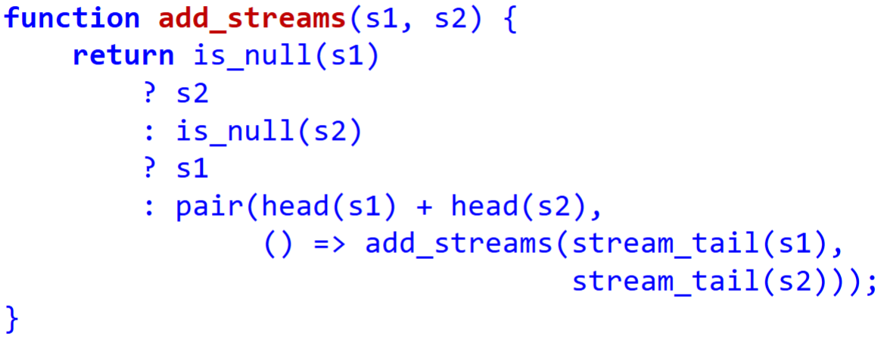
Streams II
Adding two streams
Take in two streams, return a stream the contains the element-wise sums
Overall Strategy?
Notes:
When making new stream, just add both elements at the head of both.
Base case is a little more difficult, edge cases to think about are what if s1 is null, or s2 is null.

Slide 21
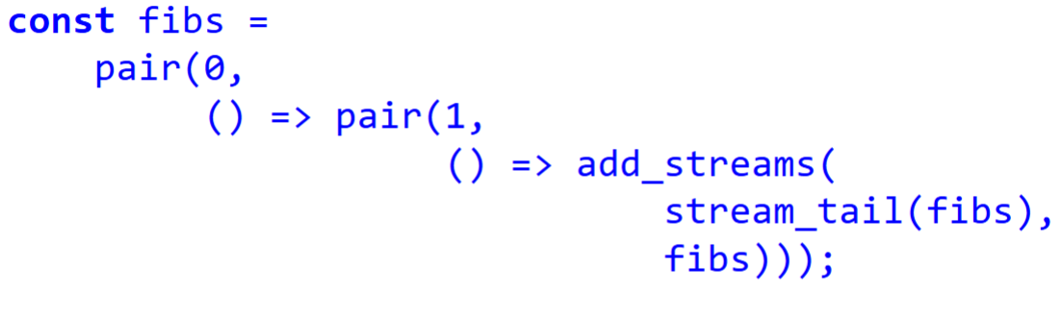
Streams II
Using add_streams to implement a stream of fibonacci numbers…
Why does this work?

Slide 22
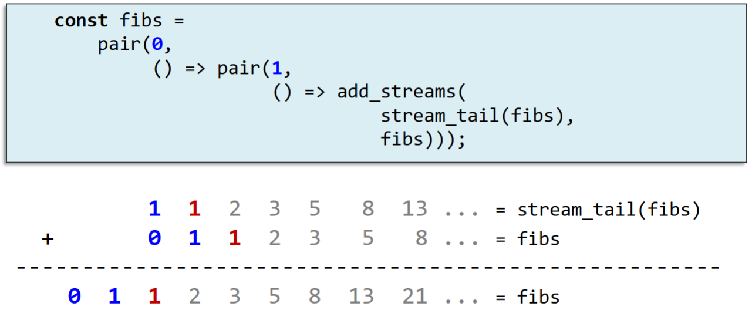
Streams II

Slide 23
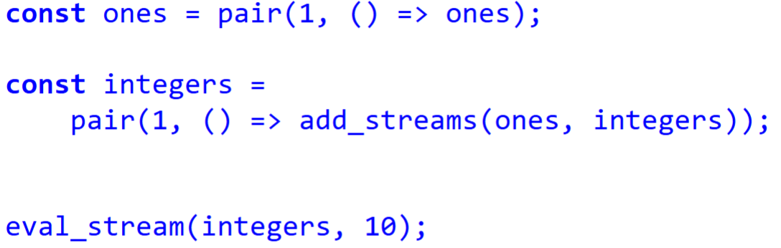
Streams II
Does this build an infinite stream of 1, 2, 3, 4, 5, … (integers)?

Slide 24
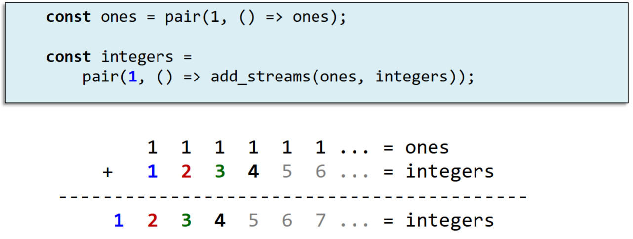
Streams II

Slide 25
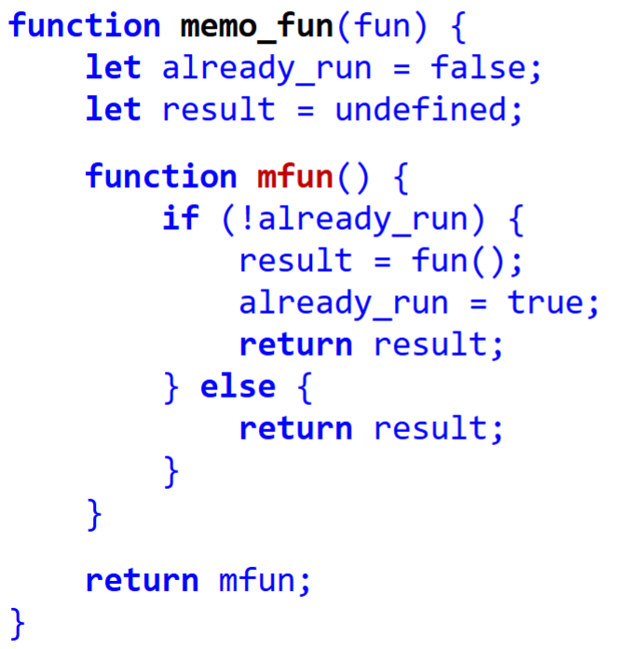
Memoized Streams
Implementation of a memoized function
Takes in a function
Checks whether we have computed fun
If we have, get the result.
Else, compute fun and save result.

Slide 26

Memoized Streams
What is the difference in outputs between the 2?
Notes:
Run in Source Academy to see the difference.

Slide 27
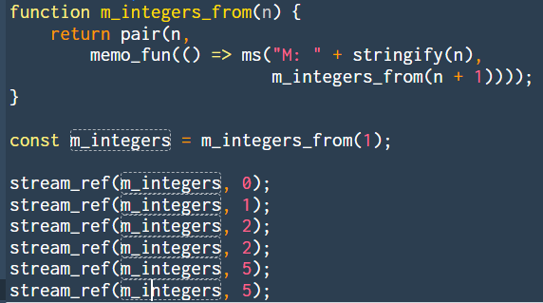
Memoized Streams
Output of the following program?
Notes:
Run in Source Academy.

Slide 28
Memoized Streams
Memoized Streams sounds great! Let’s do it all the time… Right?

Slide 29
Memoized Streams
Memoized Streams sounds great! Let’s do it all the time… Right?
Well, implementing these comes with its costs, and context matters.
Functions are often not PURE
This means that our functions have some side effect to the state of the program
Functions are not used solely for computing the output value
Function outputs are not solely determined by given input, state of program is evaluated too
Therefore, if we are using Pure Functional Programming, then yes, maybe doing the above methods are great…, as outputs are always consistent with the given inputs.

Slide 30
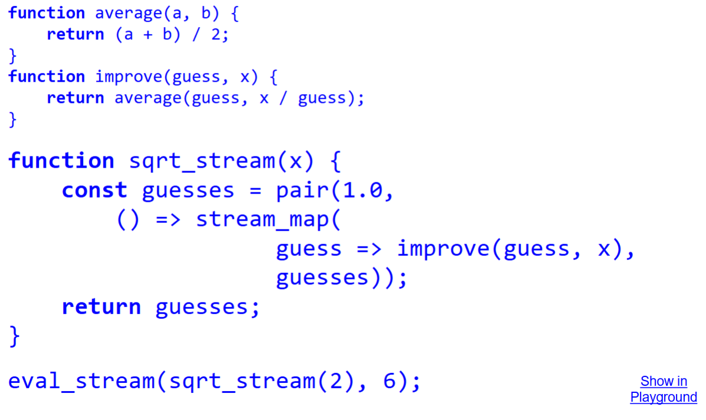
Streams for Iteration
General Idea?

Slide 31
Streams (Summary)
Streams can be used to represent “infinite” data structures
Laziness of streams allows us to do so, without fear of non-termination
Memoization can be used on Streams
Streams can also be used for iteration

Slide 32
Metacircular Evaluator
The evaluator determines the meaning of statements and expressions in a programming language. It is just another program.
We want to write an evaluator in Source that can execute programs written in Source.
Why? Gain new insight about the language and understand the environment model further.

Slide 33
Parsing
Input characters are split into meaningful symbols (or tokens), defined using regular expressions (regex)
“8 + 34;” → tokens 8 + 34 ;
During parsing,
Check that the tokens form allowable components
Produces symbolic representation of the program, syntax tree

Slide 34
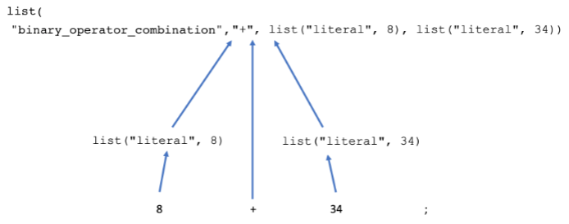
Parsing
Syntax Tree
Notes:
Recall, our definition of trees!

Slide 35
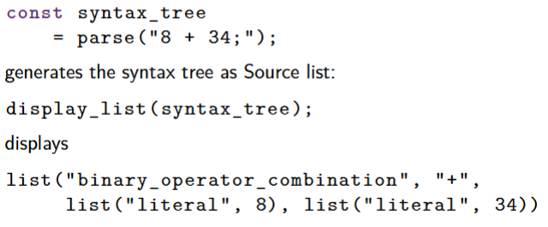
Parsing
Support for parsing in Source S4

Slide 36
Evaluation
Given some expression, evaluate the expression.
After the parsing step, the evaluator evaluates the given expression…
Let’s look at the calculator example

Slide 37
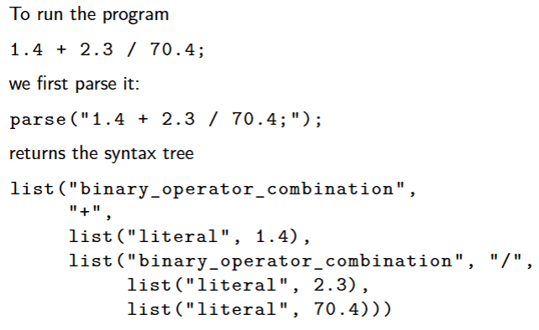
Calculator Language
Parsing Step:

Slide 38
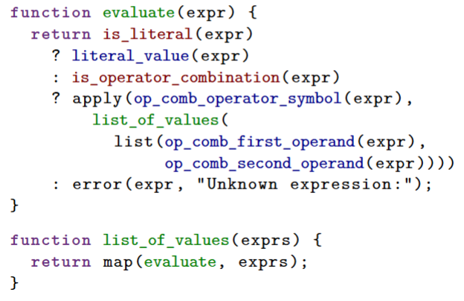
Calculator Language
Evaluation Step:
Notes:
Explaining what
is_literal (Syntax Predicate)
is_operator_combination
apply
does.
Selectors: op_comb…

Slide 39
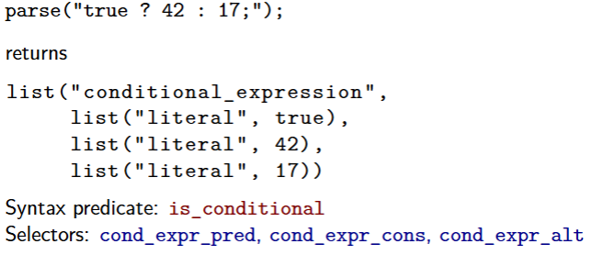
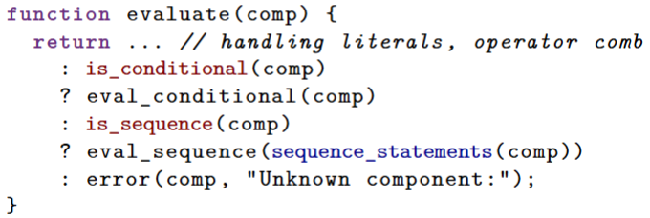
Adding booleans, conditionals and sequences
Similar idea applied when dealing with booleans, conditionals and sequences.
Notes:
Example given here is to deal with conditionals. Again, same logic applies for when dealing with sequences.

Slide 40
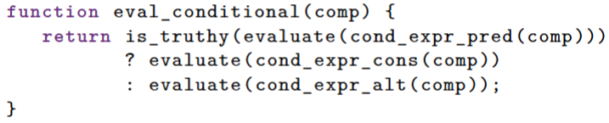
Adding…
Conditionals
Syntax Predicate: is_conditional
Selectors: cond_expr_cons, cond_expr_pred, cond_expr_alt

Slide 41
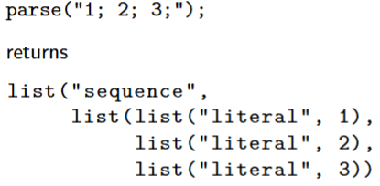
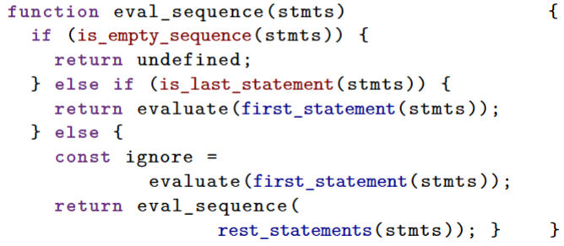
Adding…
Statements
Syntax Predicate: is_sequence, is_empty_sequence, is_last_statement
Selectors: sequence_statements, first_statements, rest_statements

Slide 42
Metalinguistic Abstraction I (Summary)
There is so much to remember/examples to go through!
Bottom line is to understand how the parsing and evaluating stage works.
And, how they use their “Syntax Predicates” to figure out what to do, and “Selectors” to pick out the data.
The purpose of this is to help us communicate the computational process called “Environment Model”.
Notes:
Lecture talks about Adding blocks and declarations, compound function (with no return) and how it handles with return statements…

Slide 43
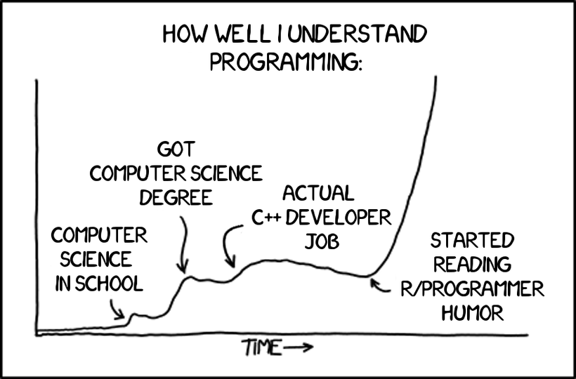
Streams II
S11 Studio Sheet & In-class

Slide 44
See you next week!
Remember to book your time slot with me for MC2!

